Slide 1
Stock Price Prediction using LSTM
By: khandil karimi

Slide 2
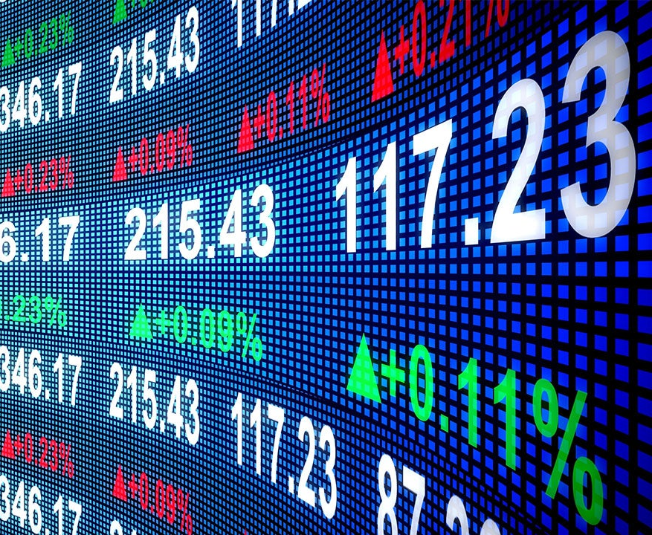
Why I chose this project
Out of the three options (RAG, KRAG, Stock Prediction), this was the most understandable and beginner-friendly
I had prior experience with a similar project using bike data earlier in the semester
The topic is practical and directly connects to real-world financial applications
Stock prediction is something many companies actually try to do using data and AI, so I found it useful and interesting

Slide 3
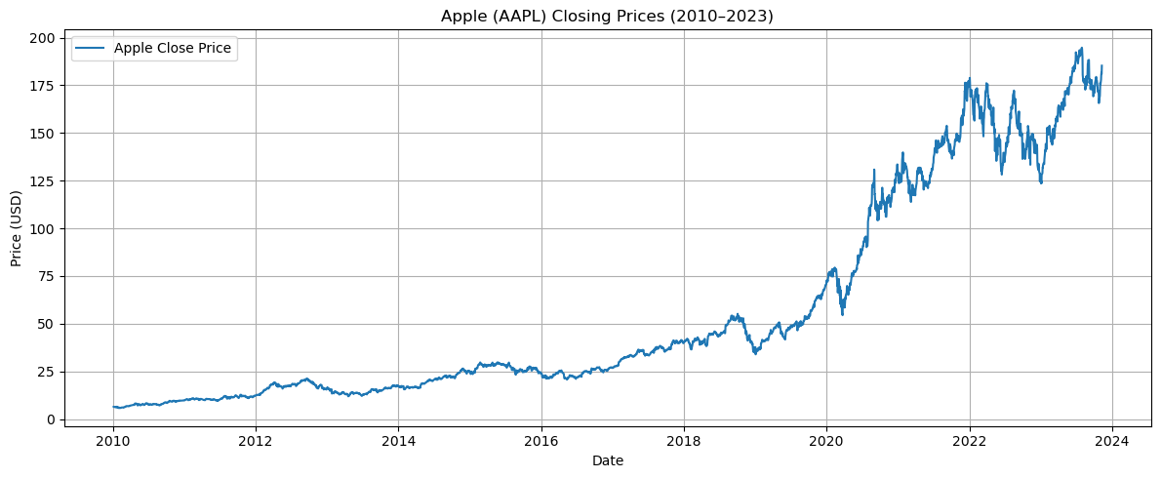
Dataset Overview
Dataset: Apple (AAPL) stock closing prices from 1980 to 2025.
Provided by instructor as a CSV file (due to yfinance rate limit issues).
Data was cleaned and scaled between 0 and 1 before training.
Total data points: Over 11,000 daily closing prices..
Focused only on the "Close" price column to simplify time-series prediction.

Slide 4




Tools and Technologies
Python programming language to write and run the code
JupyterLab to organize the workflow and view results step-by-step
matplotlib to visualize results and model performance.
MinMaxScaler from scikit-learn to normalize the data
TensorFlow and Keras to build and train the LSTM model
Provided CSV file was used instead of yfinance for historical data.

Slide 5
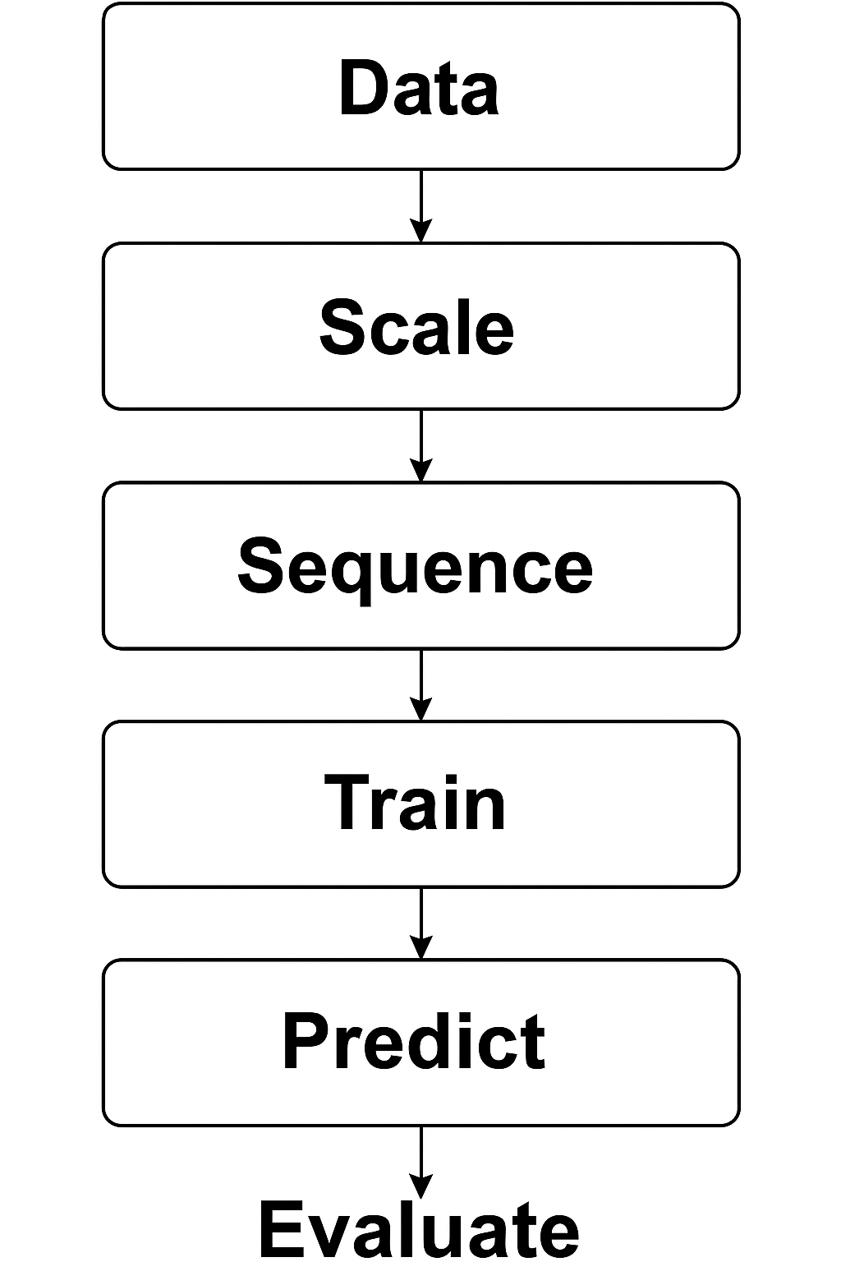
Project Process
Loaded Apple stock prices from 1980–2025 CSV dataset.
Cleaned and scaled the data using MinMaxScaler (0 to 1 range).
Created sequences of 60 days to predict the next day's closing price.
Simulated past vs. future split: first 95% of data as training (1980–2023) and last 5% as testing (2023–2025).
Built an LSTM model with two LSTM layers and two Dense layers
Trained the model for 10 epochs with a batch size of 32.

Slide 6
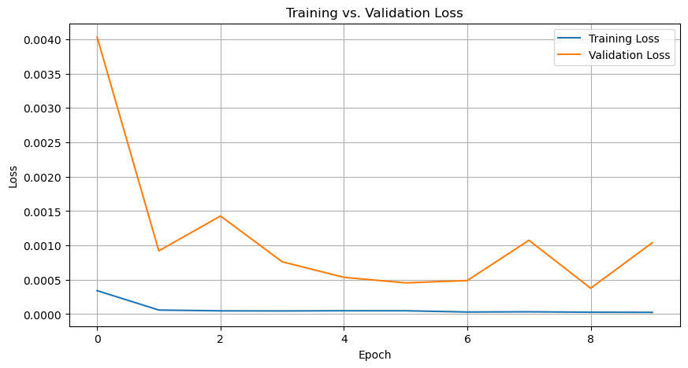
Results + Training vs. Validation Loss
Final RMSE: approximately 8.34 (Root Mean Square Error)
This means the model's average prediction error was around $8.34 per prediction.
Plotted training vs. validation loss to show learning over epochs.
Generated model architecture diagram for transparency.
Actual vs. predicted price graph showed that the model followed trends closely, with reasonable accuracy on unseen data.

Slide 7
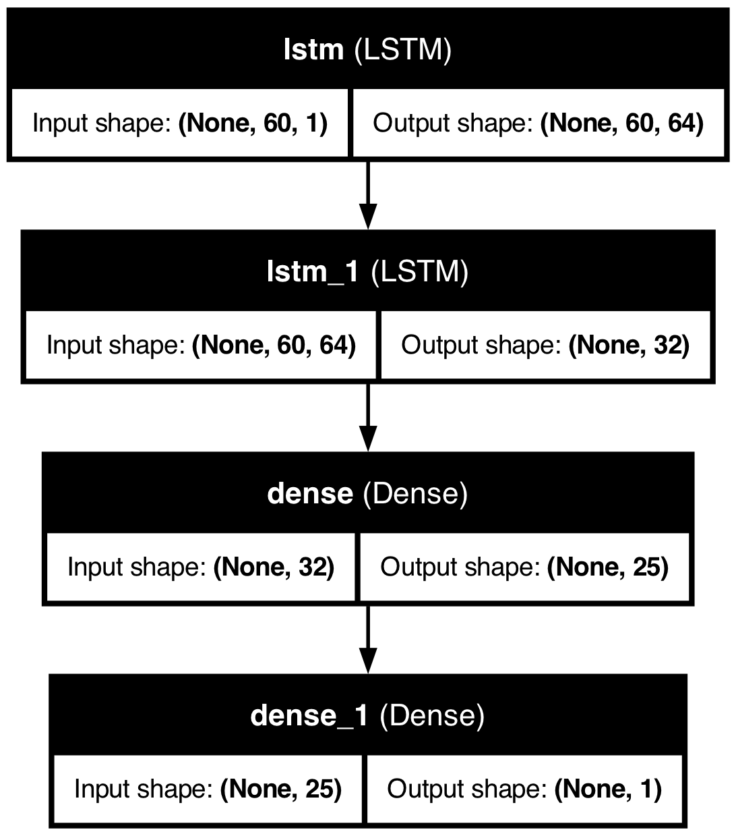
Model Architecture
The final model consisted of:
• Input layer with sequences of 60 previous closing prices
• First LSTM layer with 64 units and return_sequences=True
• Second LSTM layer with 32 units
• Dense layer with 25 neurons (intermediate layer)
• Final Dense layer with 1 neuron (to predict next closing price)
• Optimizer: Adam
• Loss function: Mean Squared Error

Slide 8
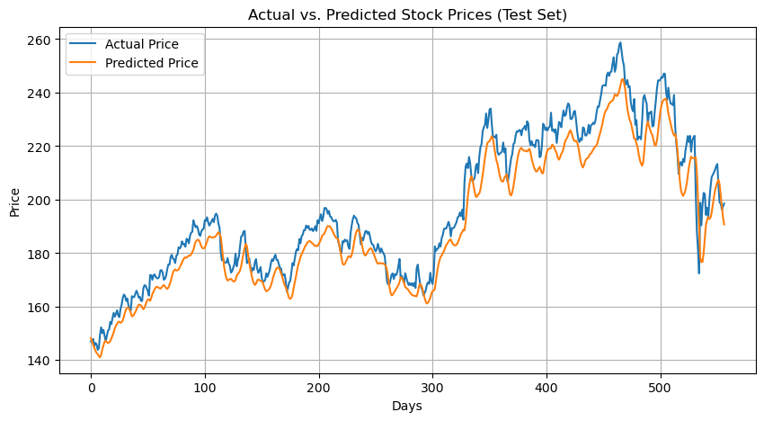
Predictions vs Actual Prices
This graph compares my model’s predicted Apple stock prices to the actual prices in the test dataset (2023–2025).
• The model followed the overall trends of the real stock prices very closely.
Small deviations are expected due to stock market volatility and limitations of using only closing price as input.
• The results show that my LSTM model was able to generalize reasonably well to unseen data.
The Root Mean Square Error (RMSE) was 8.34, meaning predictions were off by about $8.34 per day on average.

Slide 9
What I Learned
Improved my skills working with real-world datasets and data preprocessing.
Learned how LSTMs are designed to handle time-based or sequential data
Gained hands-on experience with TensorFlow, Keras, and model training basics

Slide 10
Final Thoughts
Successfully applied machine learning concepts to a realistic stock forecasting problem.
Adjusted my approach after dataset limitations (switched from yfinance to CSV).
I walked away with a clearer view of how technical skills translate into practical solutions

